Slide 1
Final Design Project
Scene 6

Slide 2
Unifying Concept
Idea
What if the Wizard of Oz took place in a future capitalist dystopia?
Meaning
The Wizard of Oz features two distinct powerful figures, the Wizard and the Wicked Witch. They work perfectly to represent powerful business owners. The rest of the citizens of Oz bend to their will, so it lends itself to a critique of how capitalism rules people’s lives while the wealthy live lavishly.
The original book was also a critique on the economy of the time, so it’s fitting to apply these same ideas to the modern world.

Slide 3
Costume

Slide 4
Research
The scene that we decided to depict took place in a cracked capitalistic future, where Dorothy comes from a Utilitarian society to Oz, which has fallen to Capitalism and the Witch is its overseer. Because we set this in the future, I really wanted shapes and layers to play a big role in the costumes themselves. I also wanted to have very distinct classes and cultures between the high class (The Witch) and the lower class (The Monkeys), as well as having a clear cultural difference between Dorothy and the rest of the characters. To research for these costumes, I looked at dark couture fashion for the Witch, as couture fashion highlights figure and shape, as well as being very grand and over the top. I looked at brands such as Dior, Mugler, Tom Ford, etc. to get an idea of how certain shapes contour the body as well as build upon itself to create illusions. For Dorothy, I wanted to highlight the uniformity of Utilitarian societies, so I looked at jumpers and other worker type outfits that could fit. I also wanted to make it more futuristic, so I researched lower income futuristic fashion and noticed lots of layers of fabric centered around the head, which I really liked because it differentiated her from the rest of the cast as well as make her look sort of like she had been traveling. Lastly, for the Monkeys, I noticed in the script it noted that they had leather wings. I really wanted to utilize leather in my design, which reminded me of bikers, so I decided to make them a part of a biker gang. This influenced my design as I could find ways to twist the biker aesthetic with a rustic, yet futuristic, looking design. I also wanted to include metallic aspects, as I noticed many futurist articles of clothing had metal accessories, so I added metal knee and elbow pads, as those are things bikers would naturally wear.

Slide 5
Moodboard
Matthew put your moodboard here
You can copy this slide if your moodboard is multiple slides

Slide 6
Moodboard (Cont.)

Slide 7
Moodboard (Cont.)

Slide 8
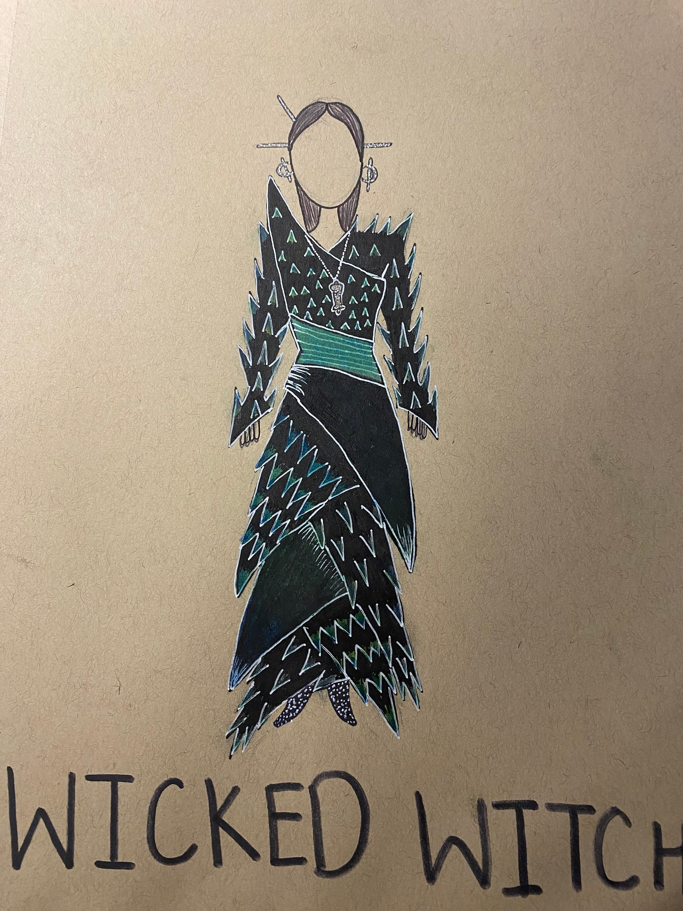
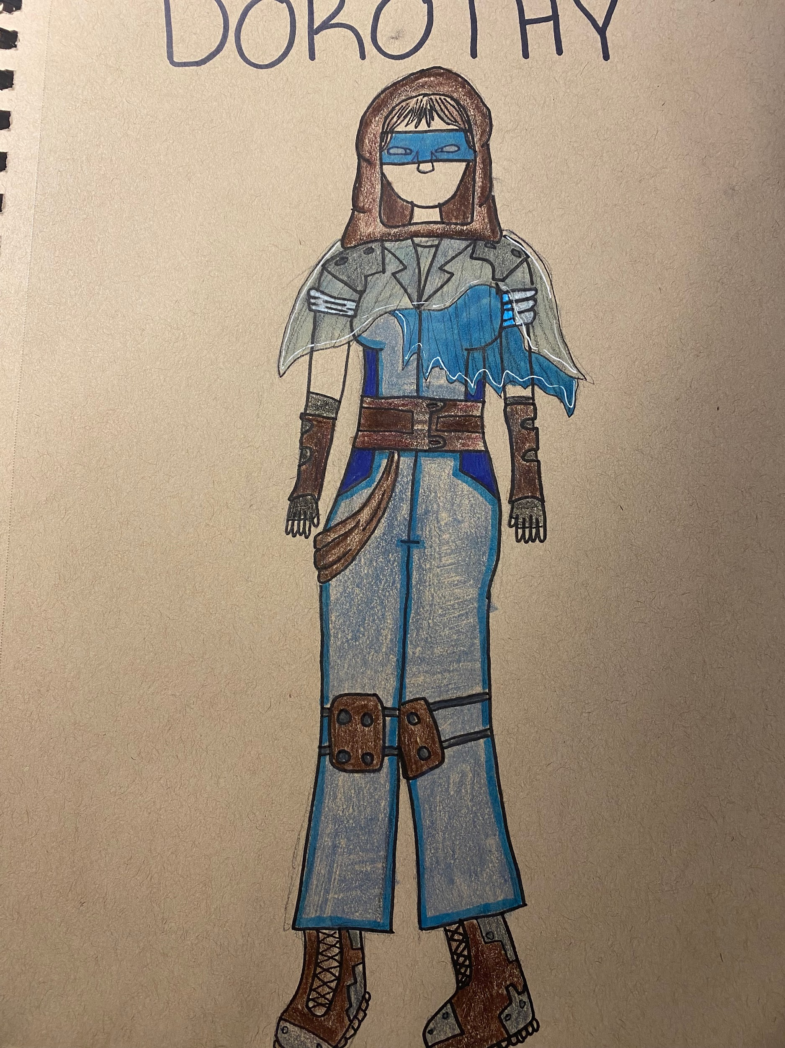
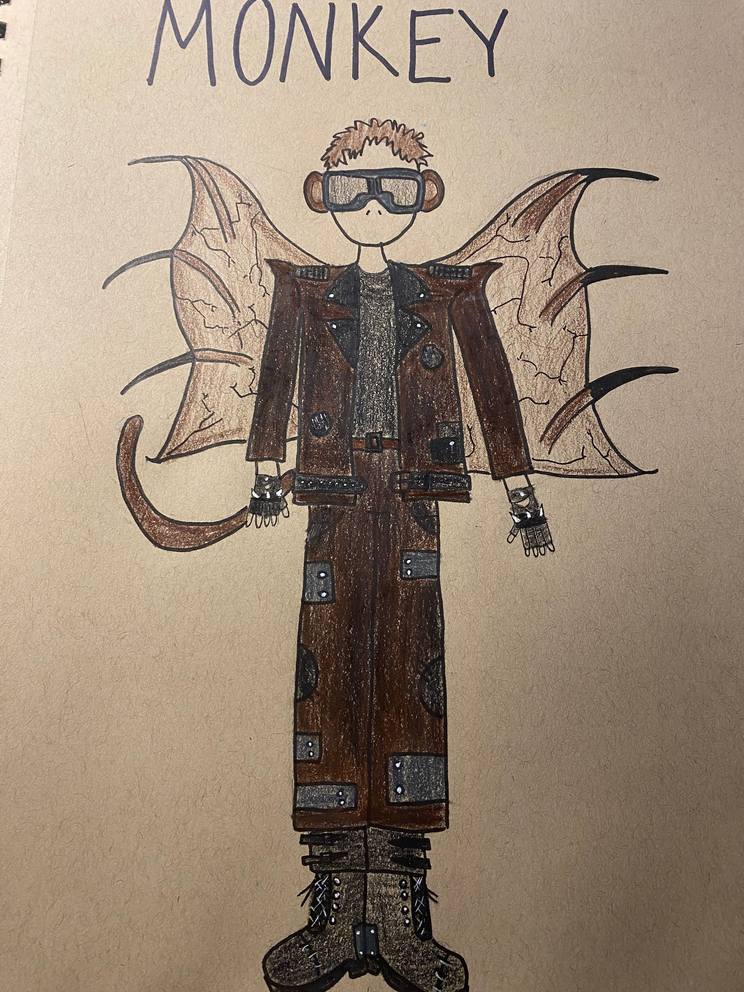
Final Designs

Slide 9
Costume pieces needed:
Wicked Witch:
Metallic hair pins
Metallic space earrings
Black dress with greenish blue spikes
Silver whistle
Green corset
Black sparkly shoes
Dorothy:
Brown hood
Blue eye mask
Light and dark blue transparent shawl
Blue jumper
Thick brown belt
Brown fabric sash
Long black sleeveless gloves
Brown sleeves gloves
Brown knee pads
Leather & metal boots
Monkeys:
Silver biker goggles
Monkey ears/ tail
Brown leather bat-esque wings
Blackish brown leather jacket and pants
Black shirt
Brown belt
Black fabric patch
Metal knee/ elbow pads
Chains
Fingerless spiky gloves
Leather boots

Slide 10
Reasoning
For the Wicked Witch, I really wanted to achieve a costume that conveyed her power and authority. I did this through sharp lines and the use of black, which also exemplified the “wicked” aspect of her character. To bring out more color, I wanted to highlight greens and blues as that portrayed the “futuristic witch”, I did this by adding spikes all over her dress and adding a corset to make her figure even more other-worldly. I also added a futuristic whistle, as it was noted that she had one.
For Dorothy, I went on a more abstract approach. Since she came from a Utilitarian society, I wanted her in a worker jumpsuit to show the conformity that comes with that society. To bring in the “blue” aspect from her costume, I made the jumpsuit blue. To make her more futuristic and add the “traveler” aspect, I added many layers to her top region as I noticed many futuristic designs included them. This helped differentiate her from the people of Oz, and the Witch especially as the Witch was a wealthy Capitalist, and everyone else were lower income people screwed by the system. I also brought in some leather and metal aspects to make it more rugged and futuristic.
For the Monkeys, I took inspiration from the script where it noted they had leather wings. From here, I decided to design them as bikers, since I noted “leather” and “flying” as part of their characters. To make them more futuristic, I also added sharp and straight lines as well in their costume. I brought in the monkey aspect by adding monkey ears and a tail. I wanted them to polarize the Witch as she was exploiting them, as seen in Capitalist societies, with very few wealthy in control and many under them in poor conditions. To bring in the biker aesthetic, I used spikes, leather, boots, gloves, and goggles to add more dimension to the character. Instead of having just black leather, I wanted to make it dark brown, as many monkeys are often brown.

Slide 11
Set

Slide 12
Research
We set our play in the future, so researching technology and trends of the time wasn’t possible. Instead, I mostly focused on researching what sorts of modern architecture is feasible, along with looking at different sci-fi media to use as inspiration.
Lots of modern architecture has shapes and ledges that seemingly defy gravity, but metal is malleable but strong so it is a good material to use for twisty shapes in buildings. That means metal is a good choice of material since it’s not only practical, but fits the visual idea that comes to mind when people think “futuristic.”
Many people think modern architecture is ugly and unappealing which actually came as a shock to me while researching since I think wacky buildings are beautifully innovative and impressive. People want buildings in predictable shapes, so something impractical that sticks out is perfect for the dwelling of a villain like the witch. Buildings like these are also typically very expensive to make since their so complex, which fits perfectly with the commentary on capitalism our design of this play is trying to make.
Finally, I wanted to research common trends in office buildings. This was fairly simple. Office buildings are rigid, samey, and utilitarian. I wanted to incorporate some of those features into the more wild design so it’s still communicated that this is a place of work, and that the witch is also a businesswoman.

Slide 13
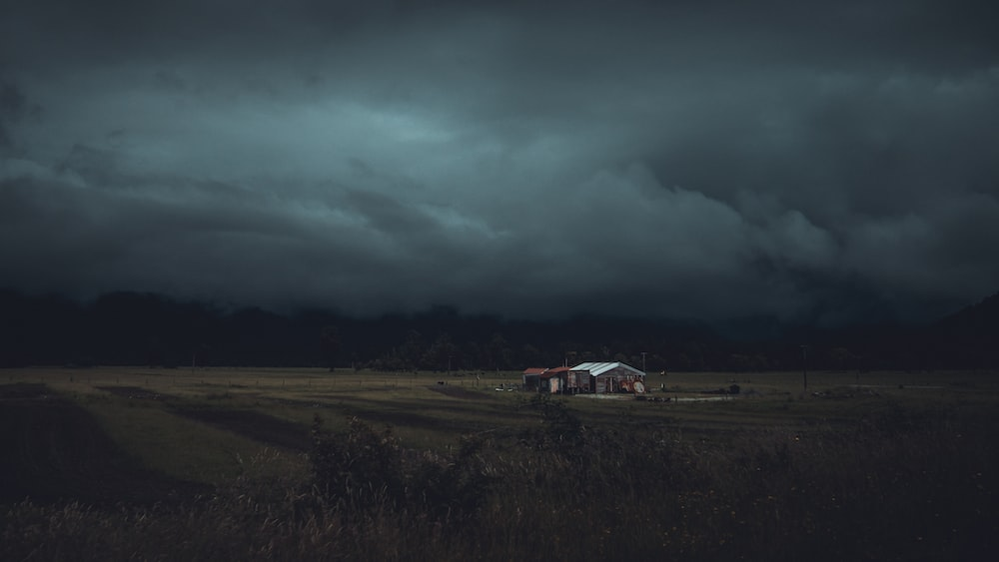
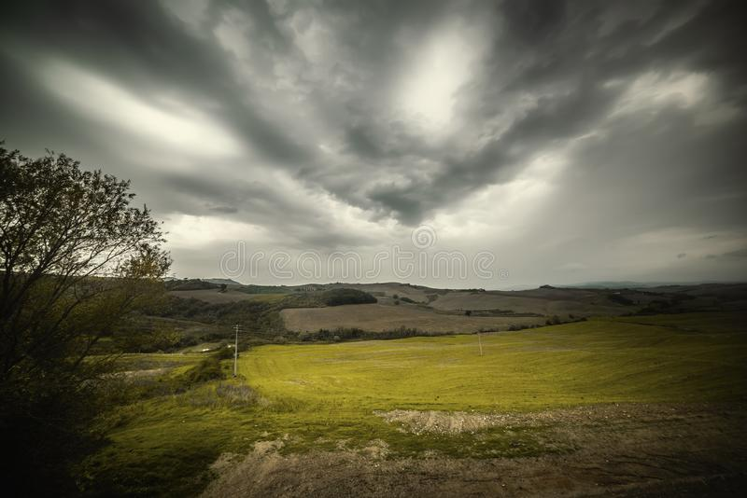
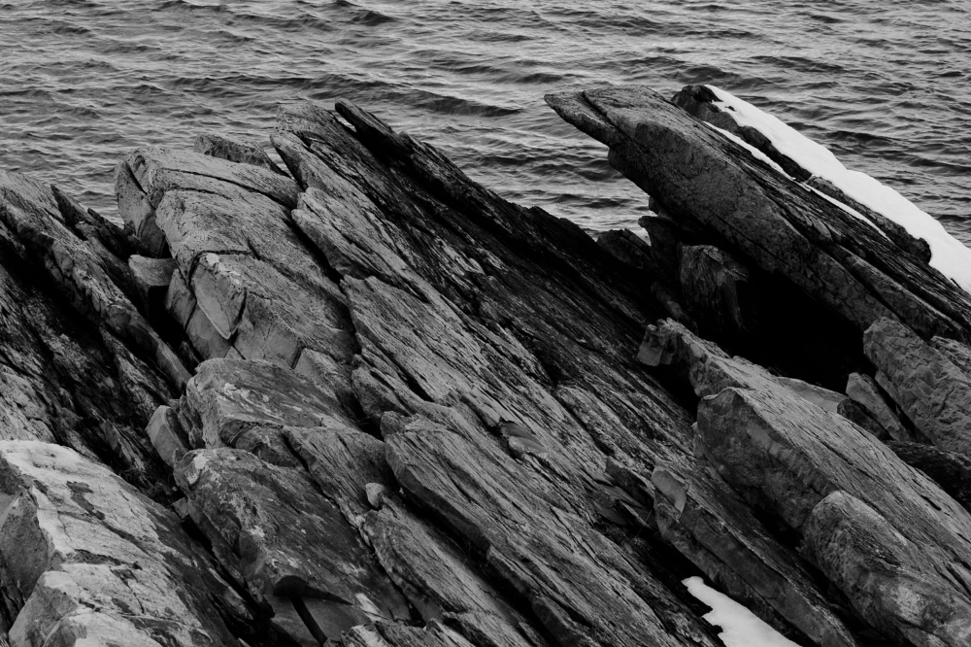
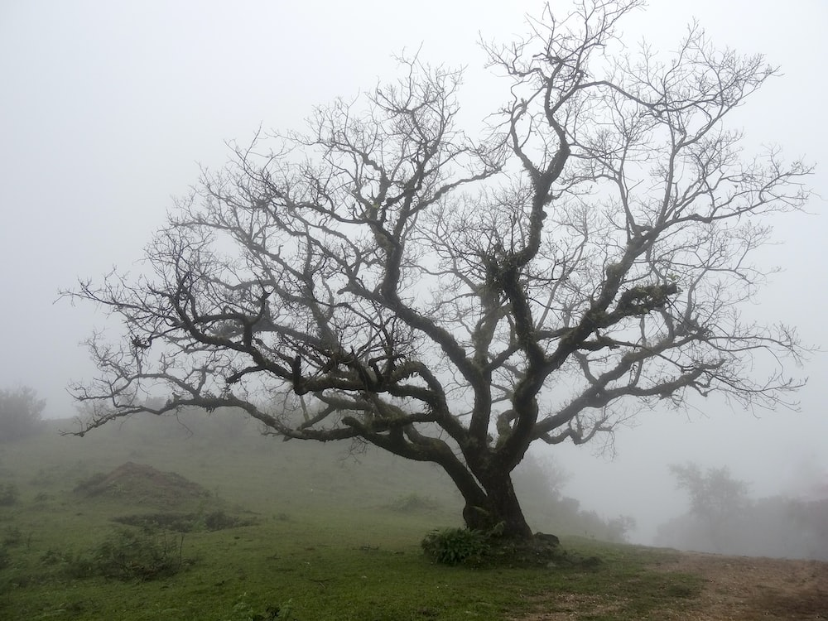
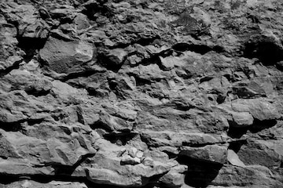
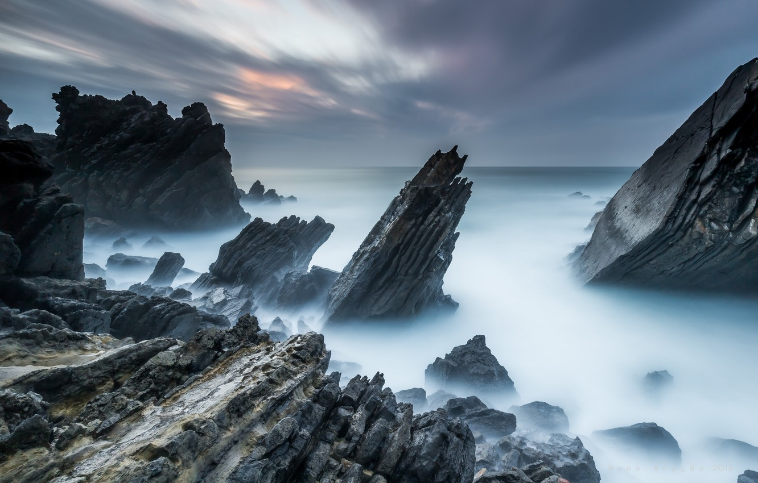
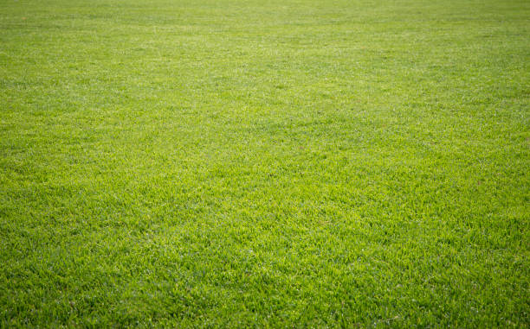
Moodboard
Outside the witch’s castle
Fields

Slide 14
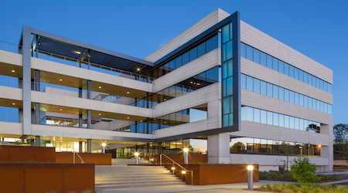
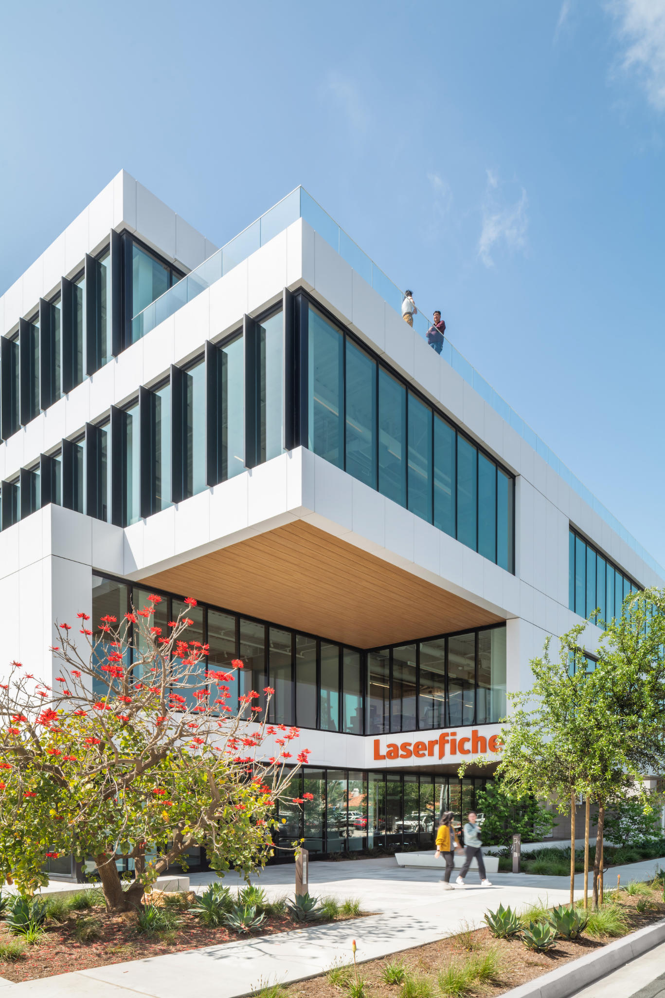
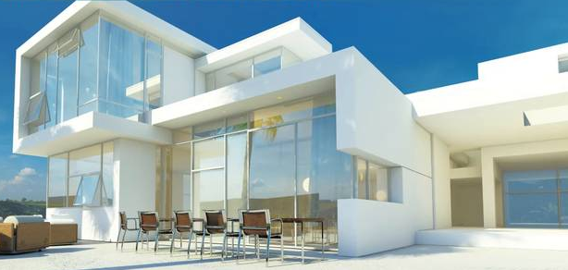
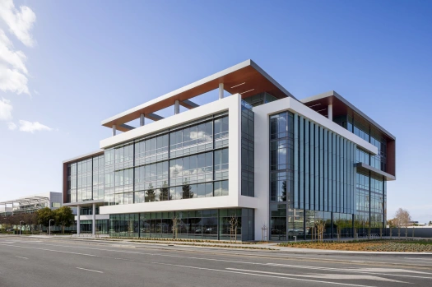
Office Buildings
Witch’s castle

Slide 15
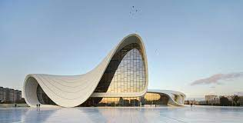
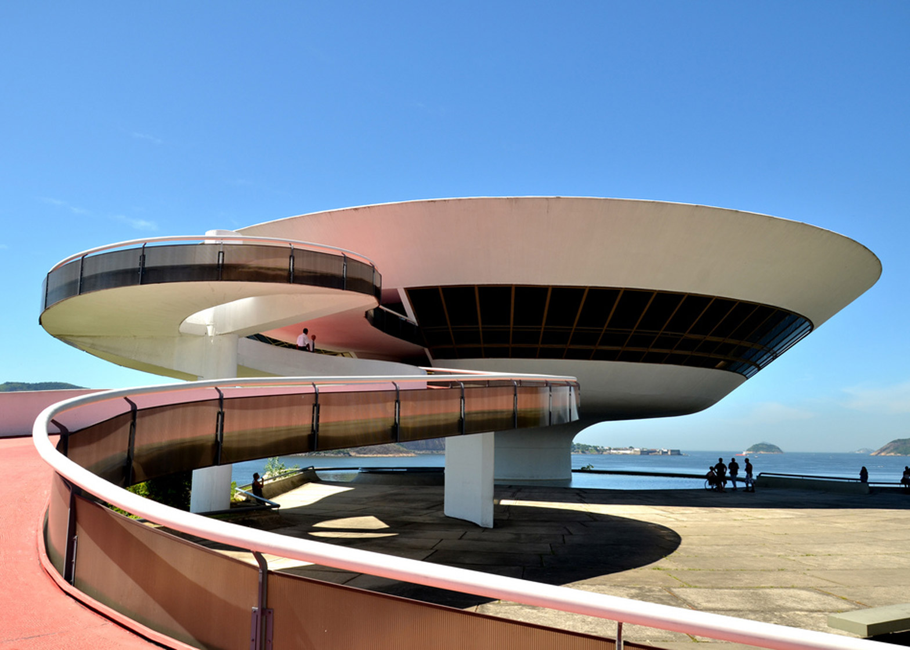
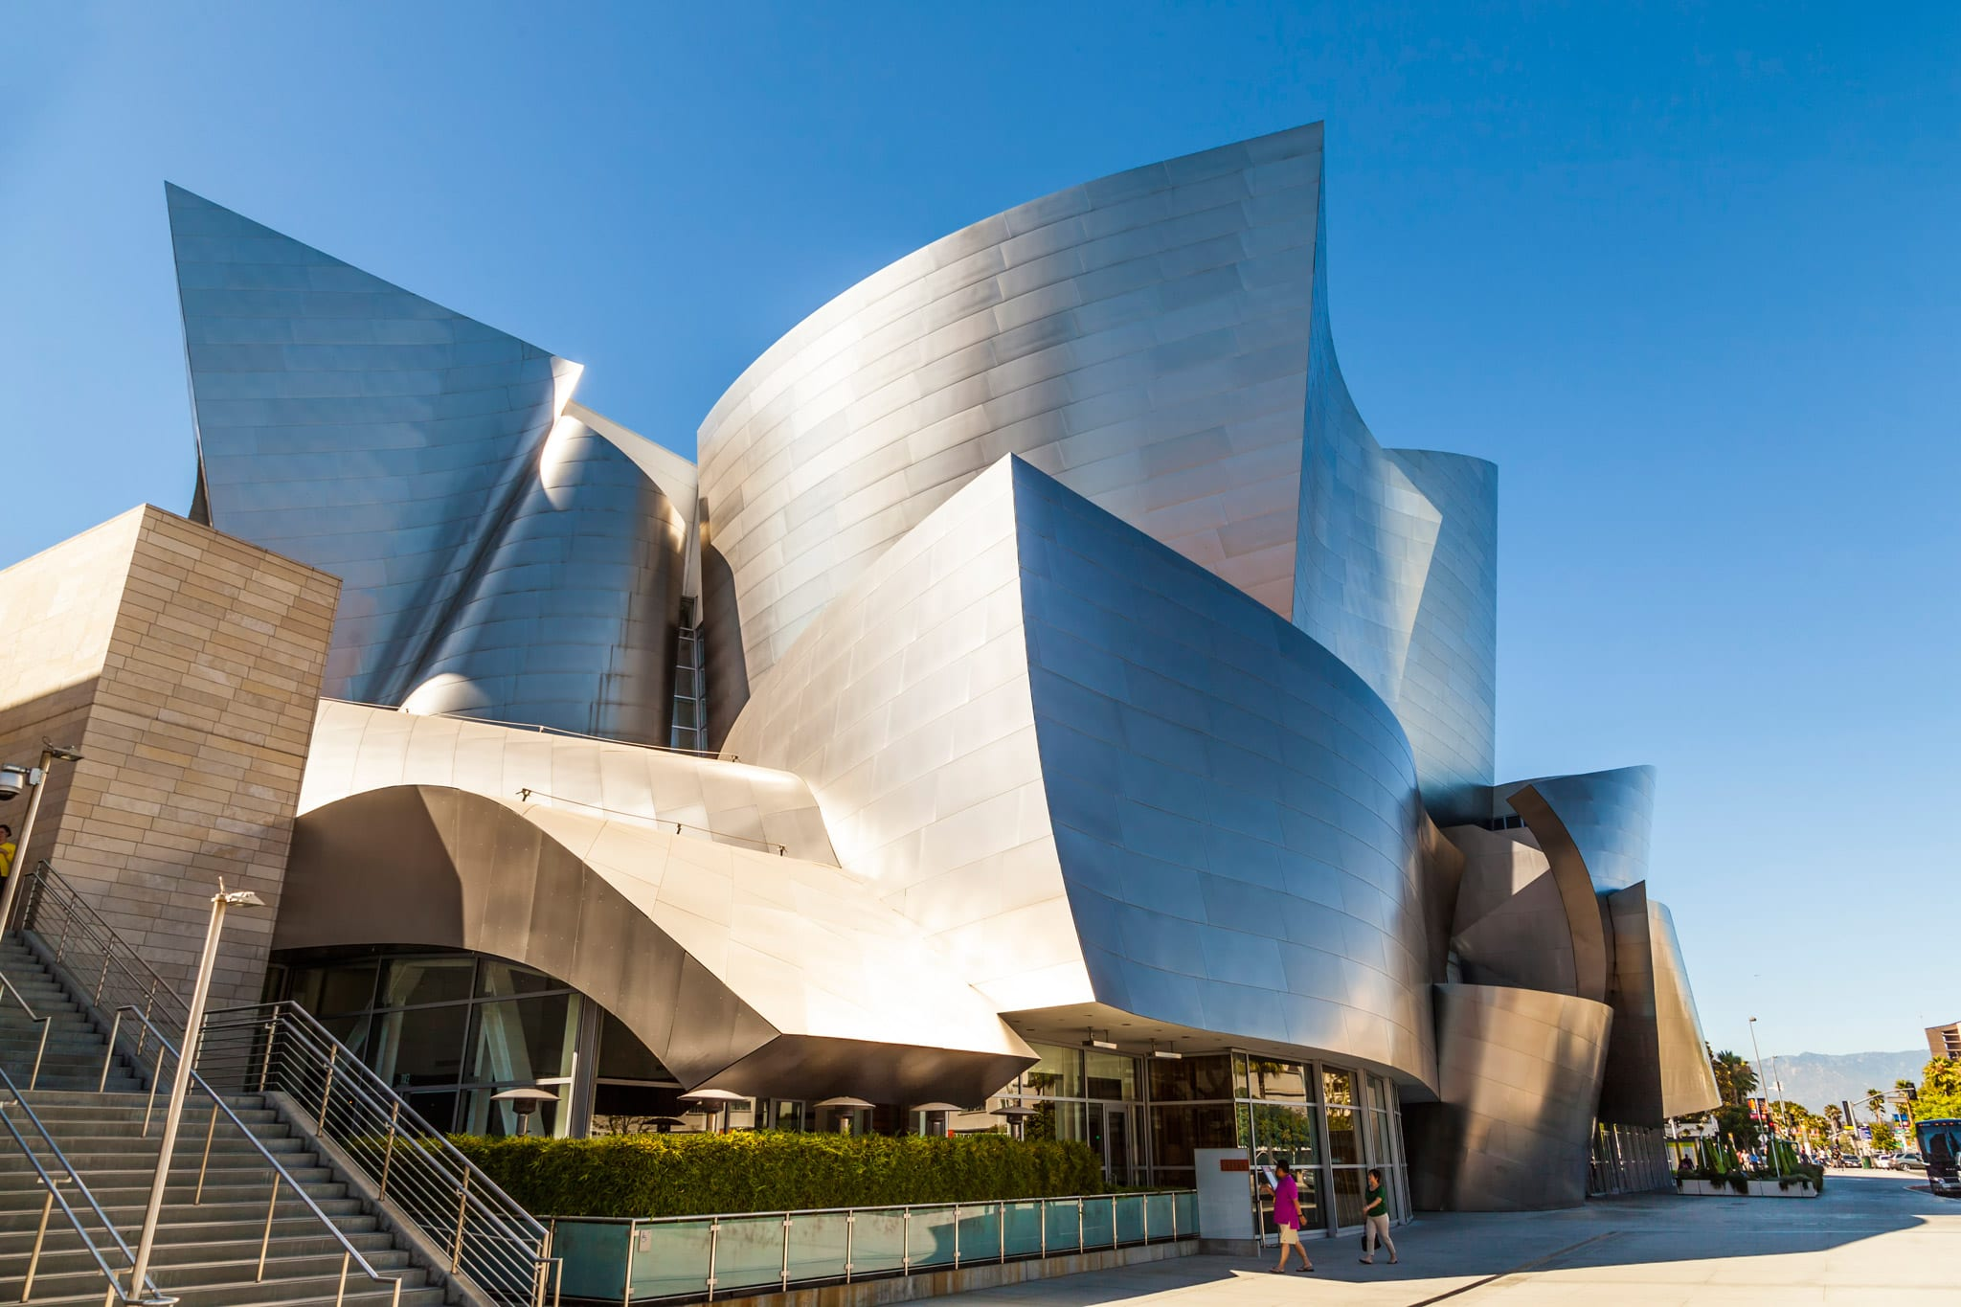
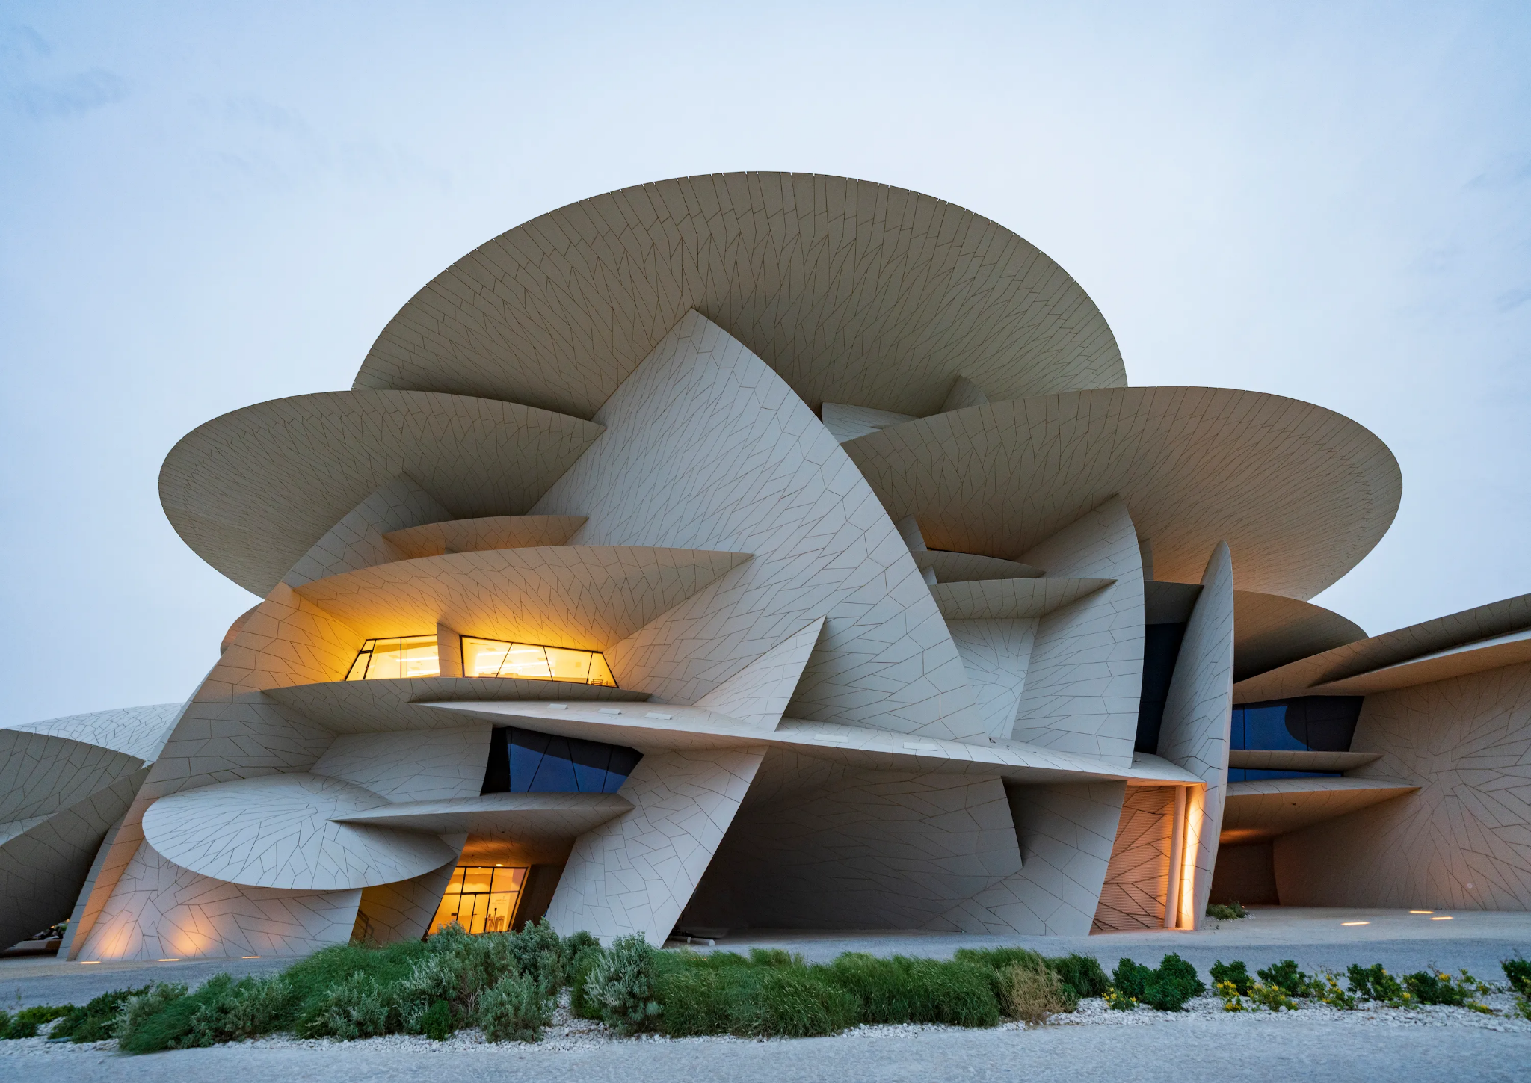
Strange Architecture
Witch’s castle

Slide 16
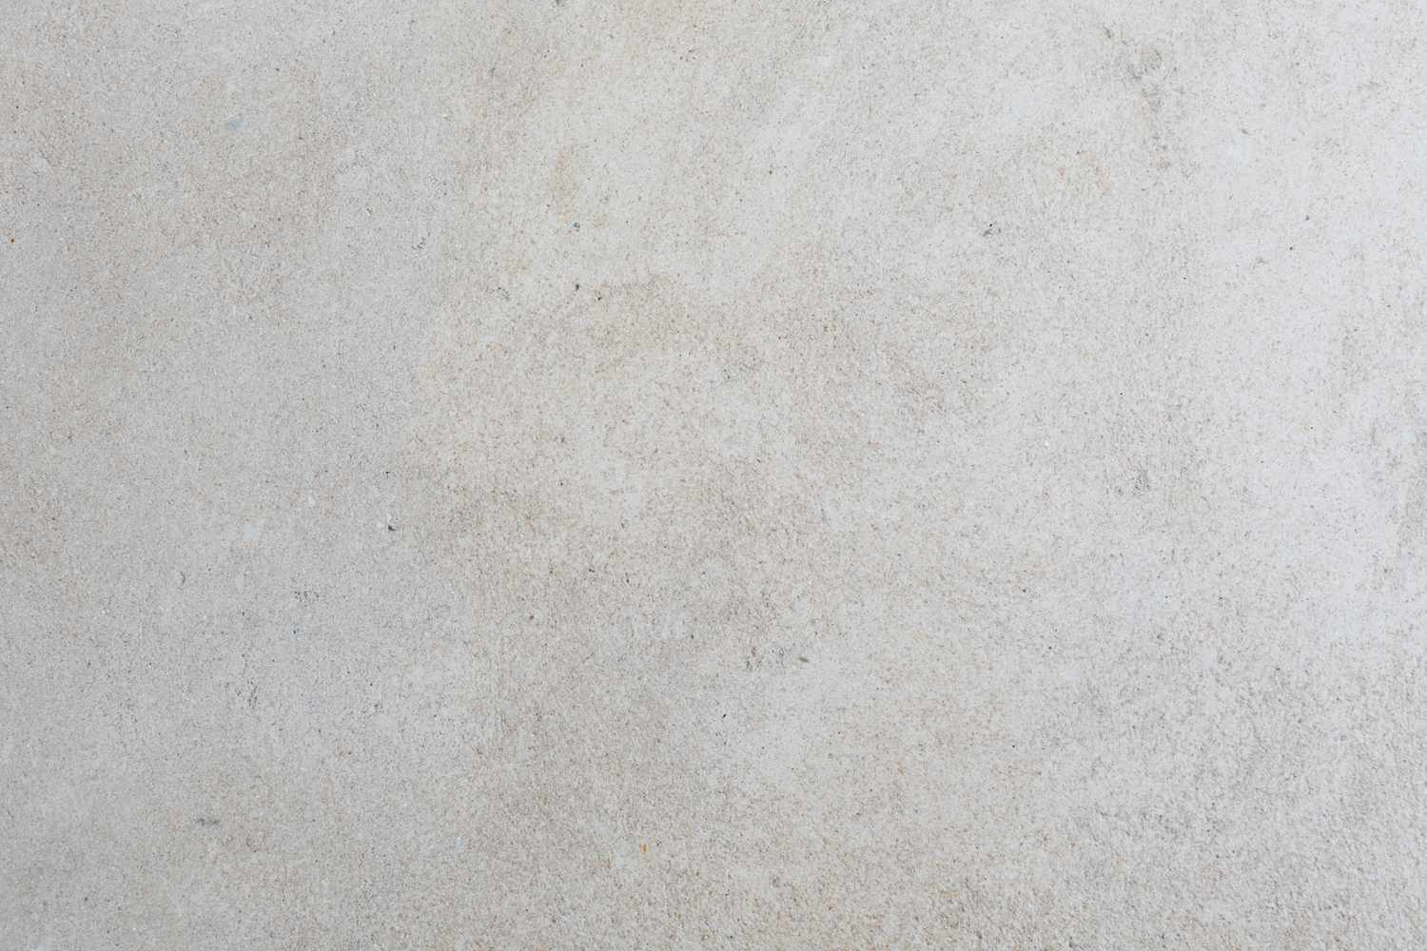
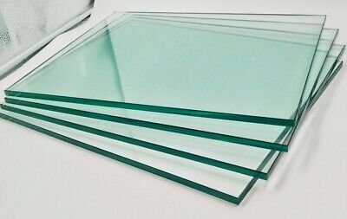
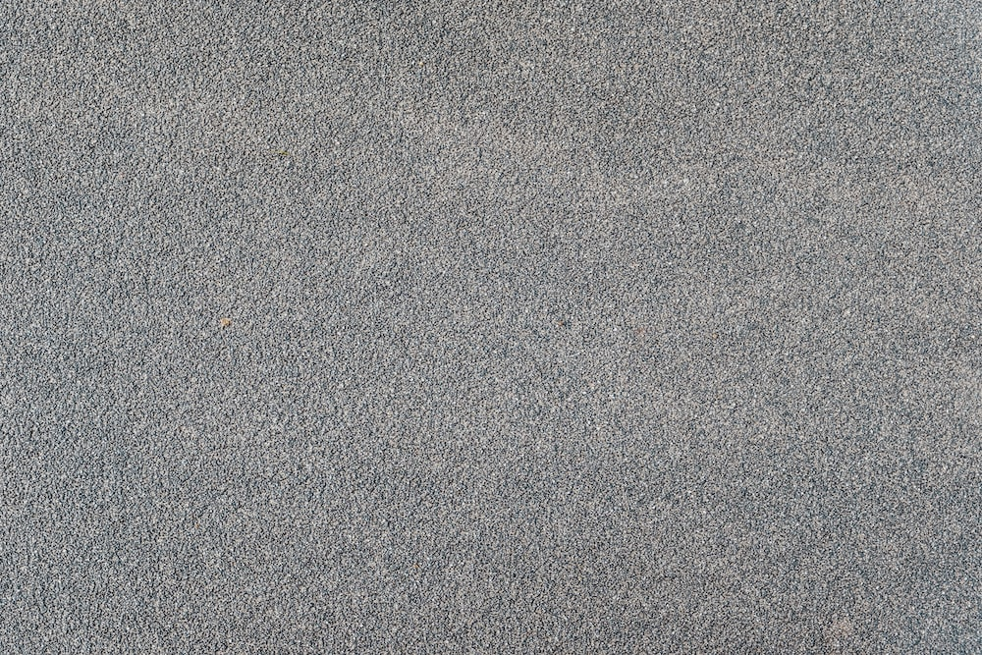
Colors & Textures
Witch’s castle

Slide 17
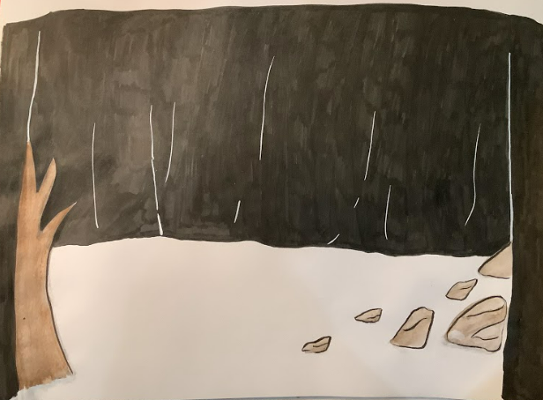
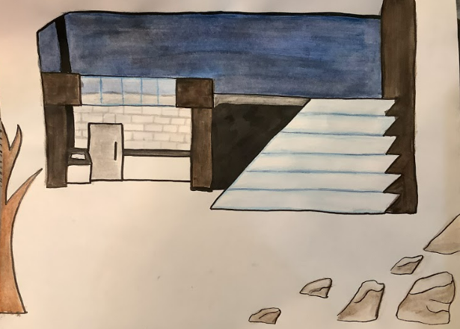
Final Design

Slide 18
Explanation of the Designer’s Choices
This scene consists of two main settings. The first is the witch’s castle, and the second is a field just outside of the witch’s castle. In order to make the transition between these two scenes smoother, I decided both sets would be on stage at once. The traveller would just be opened or closed depending on if the witch’s castle is the focus or not. This works in universe too since the field is just outside of the witch’s castle.
This would be primarily constructed out of wood, as the castle does not have to be moveable, but it needs to be sturdy.
The rocks would be constructed out of foam so that actors would not get hurt when they are dropped on the rocks.
The balcony on the second floor of the witch’s castle juts out slightly, and the railing is made of glass.

Slide 19
Explanation of the Designer’s Choices (Cont.)
The field is minimal and barron. This is not only to help create a lonely feel, but it’s also practical. Too many set pieces would block the castle when it was onstage. The scene required sharp rocks that the Tin Woodman is dropped onto by the monkeys, so that had to be included. The tree helps balance the scene and also show that we are outside in a gloomy, decaying setting.
The witch’s castle is where I really wanted to let our unique concept shine through. The castle is a mixture between a modern home and an office building, with strange and impractical jagged geometry. I wanted to invoke the feeling that many wild modern structures do, but I had to do so without designing much exterior since the audience obviously needs to see what’s going on within the castle. I settled with this jagged two story section of the building being displayed. There is a small kitchen on the lower floor. This is specifically mentioned in the script, so it had to be included, but I didn’t want it to be a big focus point. The balcony on the second story is the real show-stopper. This is where the witch can stand imposingly over the rest of the scene as she converses with the monkeys and sends them after Dorothy and friends, which really helps communicate the power she wields in this world.

Slide 20
Lights

Slide 21
Research
As the lighting designer of this version of the Wizard of Oz, my research consisted of different forms of the media’s idea of the future and what it would look like. I picked the different pictures and such that I thought fit our version of the Wizard of Oz set in the future. Looking at these pictures gave me ideas of different textures, lights, and materials. This kind of stuff can be very important to a lighting designer. I noticed that a lot of people see the future in a lot of blue lights. I also found a lot of bright vibrant colors. I had to mix these bright colors with the dark colors of the scene we are designing. I also researched different images of overcasted areas because that is one of the vibes we were going for.

Slide 22
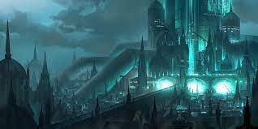
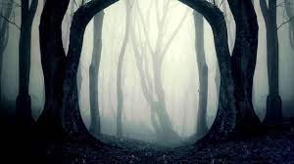
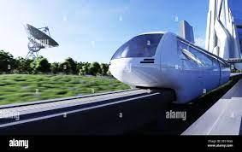
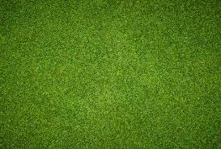
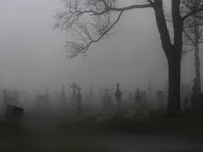
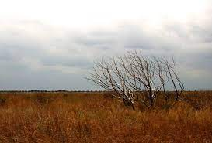
Moodboard

Slide 23
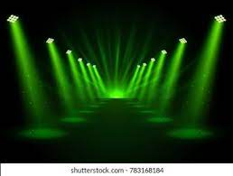
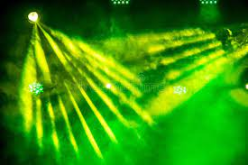
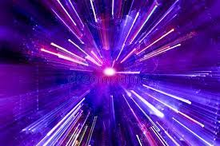
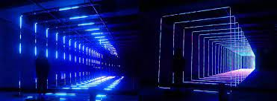
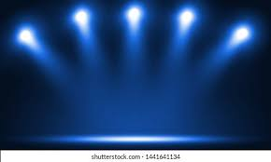
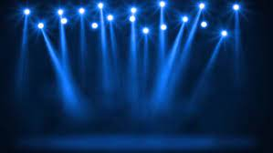
Mood board (Cont)

Slide 24
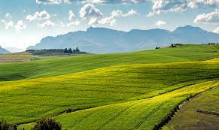
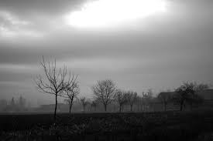
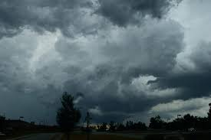
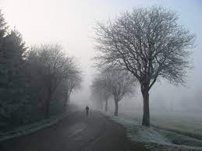
Mood Board (Cont)

Slide 25
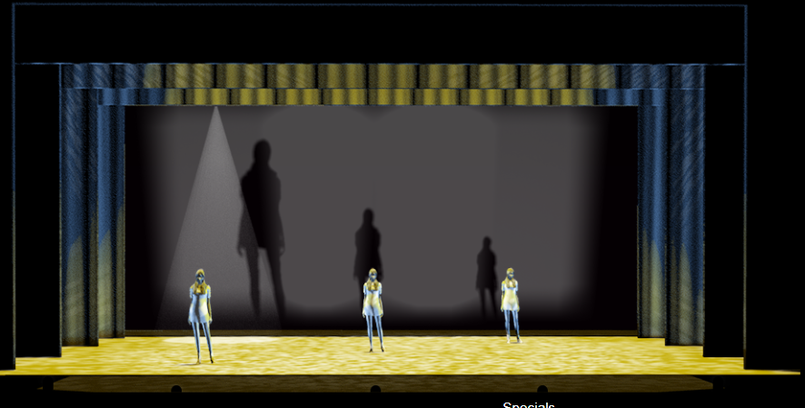
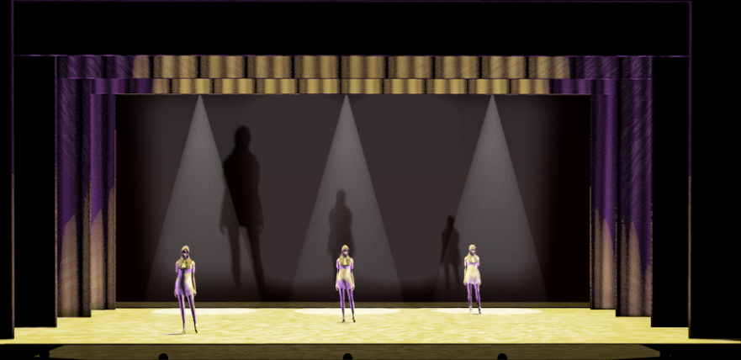
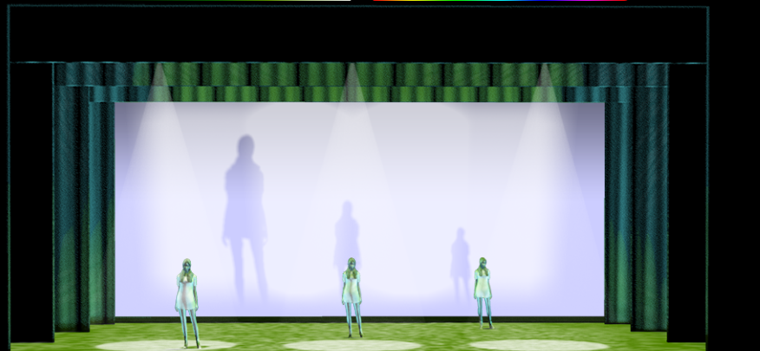
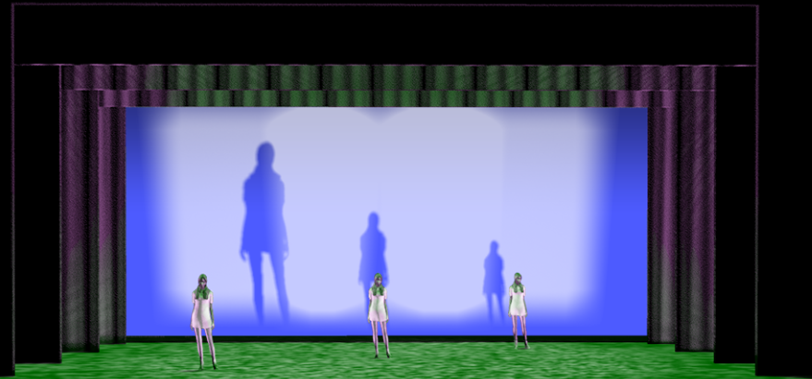
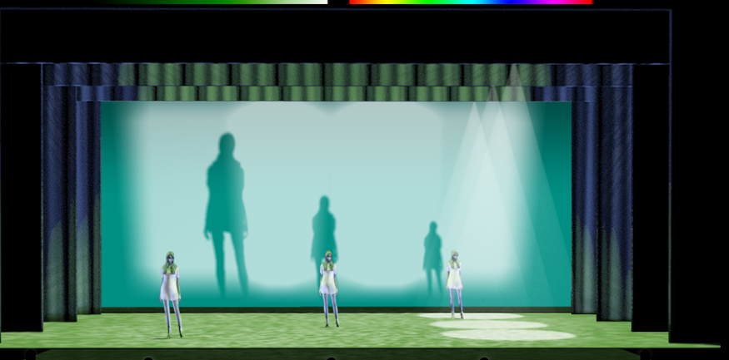
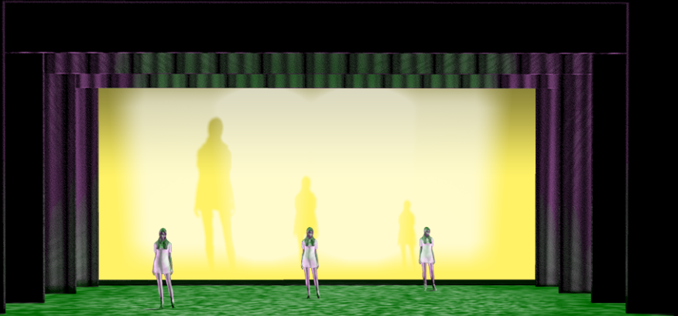
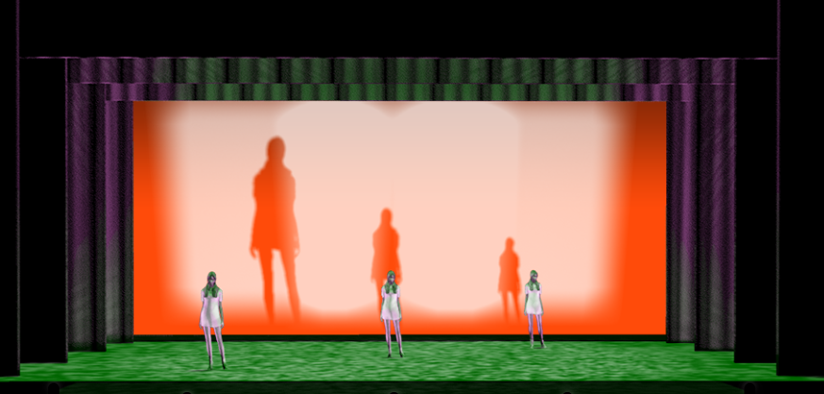
Final Design

Slide 26
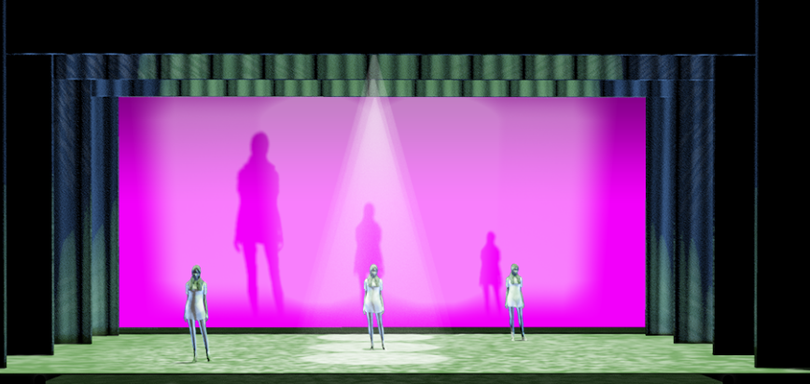
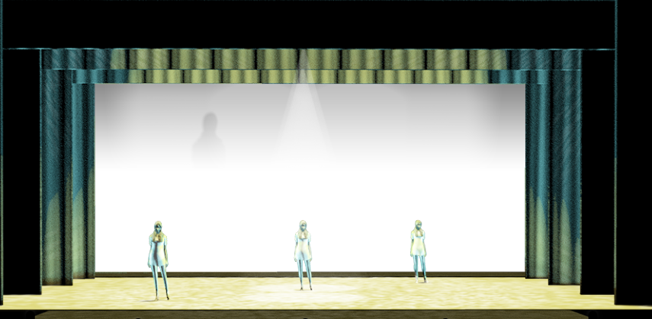
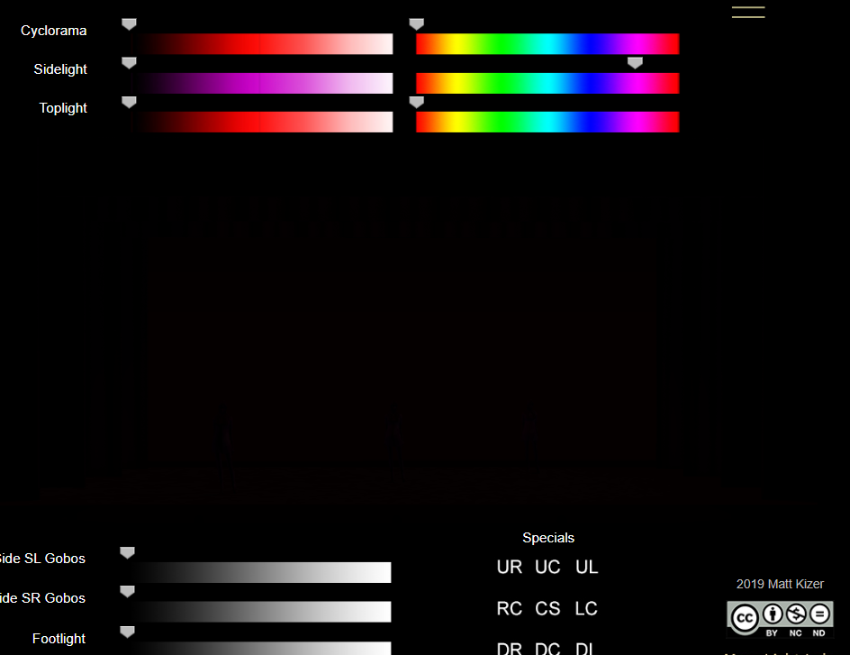
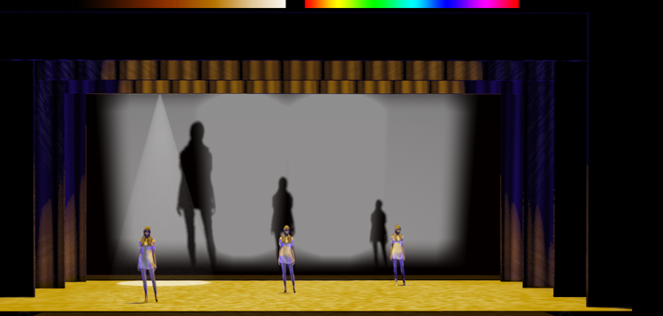
Final Design (Cont)

Slide 27
Cue Sheets

Slide 32
Explanation of the Designer’s Choices
Starting with my first one, it is the witch’s castle is the opening to my group’s scene. I wanted to give off spooky vibes and I think the dark background and the shade of the colors I use help give off that spooky vibe. Our version of this play is very futuristic and in this vision there are a lot of blue lights in this atmosphere and other colors help blend.
For my next light cue, the blue lights change into an ominous purple, purple lights will come on every time the monkeys appear, which adds to their odd appearance.
The next light cue changes to the field where Dorothy gets kidnapped, I went for an overcast type weather and used the footlight to add some fog. The green top light shows they are in a field.
Now for my next cue, the monkeys appear, so that means purple. The blue background symbolizes the monkeys attacking the Tin Woodman. For the next few cues there will be a color in the background that symbolizes the character in focus. This will help the audience stay on track. The grass gets darker to give a more serious feel as the monkey cause havoc.
My next design has yellow in the background to symbolize that the scarecrow is being attacked.
The orange background on this one shows that the lion is being attacked. These light cues will happen back to back as characters get attacked.

Slide 33
Explanation of the Designer’s Choices (Cont.)
My next cue the background has turned light blue. I try to keep the green there to show we are in the field. The background is light blue because this shows the monkeys attacking Toto.
My next cue this is where Toto and Dorothy are having a cute moment. I brightened up the grass and gave a cute pink background to compliment the cute nature of this part.
This next cue is where we see the bright silver mark on Dorothy’s head and the lights get very bright and illuminate the stage as if the mark on her head is giving very powerful light effects. The cyclorama and the sidelights are up to 100 and you can see faint shadows in the distance.
The next cue is a blackout as we transition from the field to the castle without it looking awkward.
My next light cue, we are back at the witch’s castle. The yellow and blue, have gotten darker to make it look the witch has been preparing to get her shoes back.

Slide 34
Explanation of the Designer’s Choices (Cont.)
There will then be a light change really quickly as the symbol on dorothy’s head appears again. The same light design from last time comes back.
My next light change is when Toto becomes frozen. There is a very bright blue for the sidelight .
When the witch mentions the Scarecrow and Tin Woodman, the lights will change back to the one before the symbol shows up again
My last design is the part where Dorothy pours water on the witch and for this design I went for blue colors to add the effect that the witch is melting.

Slide 35
Sound

Slide 36
Research
For our scene, we went with a futuristic concept. This influenced my design with the sound and how I incorporated traditional sounds with the technology and vibe of the future. For example, my scene utilized animal sounds, like bats flying or lion roaring. I wanted to add a futuristic twang to these animals’ sounds. For the research portion, I had to utilize images and sounds from dystopian or futuristic films, art, and architecture to get a feeling for how I wanted to design the sound for this scene. Since our concept is not inherently realistic and exists beyond modern society, it was a bit of a challenge to find inspiration. It also incorporated some fantastical elements, so I wanted to be sure I could incorporate those, too.

Slide 37
Moodboard
Sound Design Moodboard

Slide 38
Final Design
Sound Folder

Slide 39
Cue Sheet
Picture Link (in case photo attached is illegible)

