Slide 1
Top Ten Tips for a Virtual Performance
Notes:
Hello and welcome to EDTA’s Top Ten Tips for a Virtual Performance
We understand that your productions may look and be different in this COVID-19 world, so we’re going to cover a few tips and tricks to help you better plan your season and production.

Slide 2
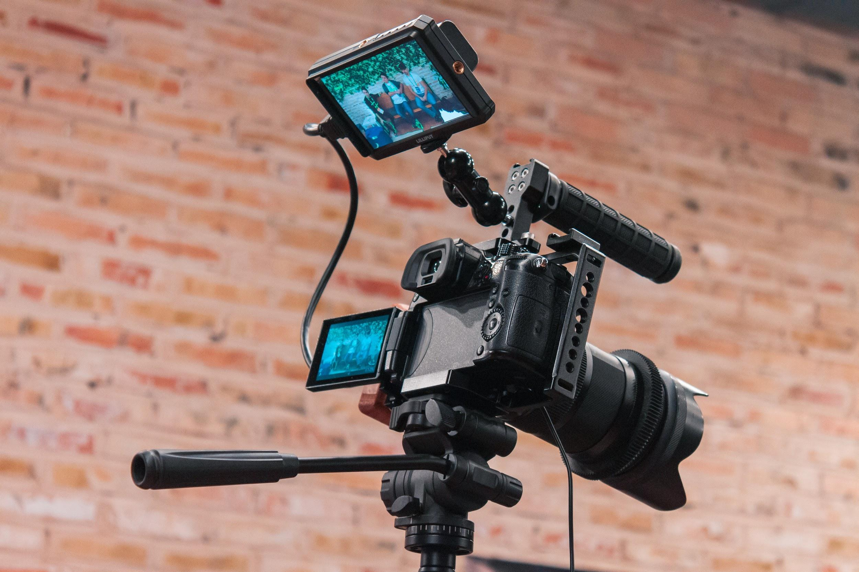
Top Ten Tips for Virtual Performance
Performance
Research Light Setups
Use Digital Backgrounds
Experiment with Props
Learn to use Broadcast or Switching Software
Notes:
We have broken the Top Ten Tips into three different presentations; Pre-Production, Rehearsal/Tech, and Performance.

Slide 3
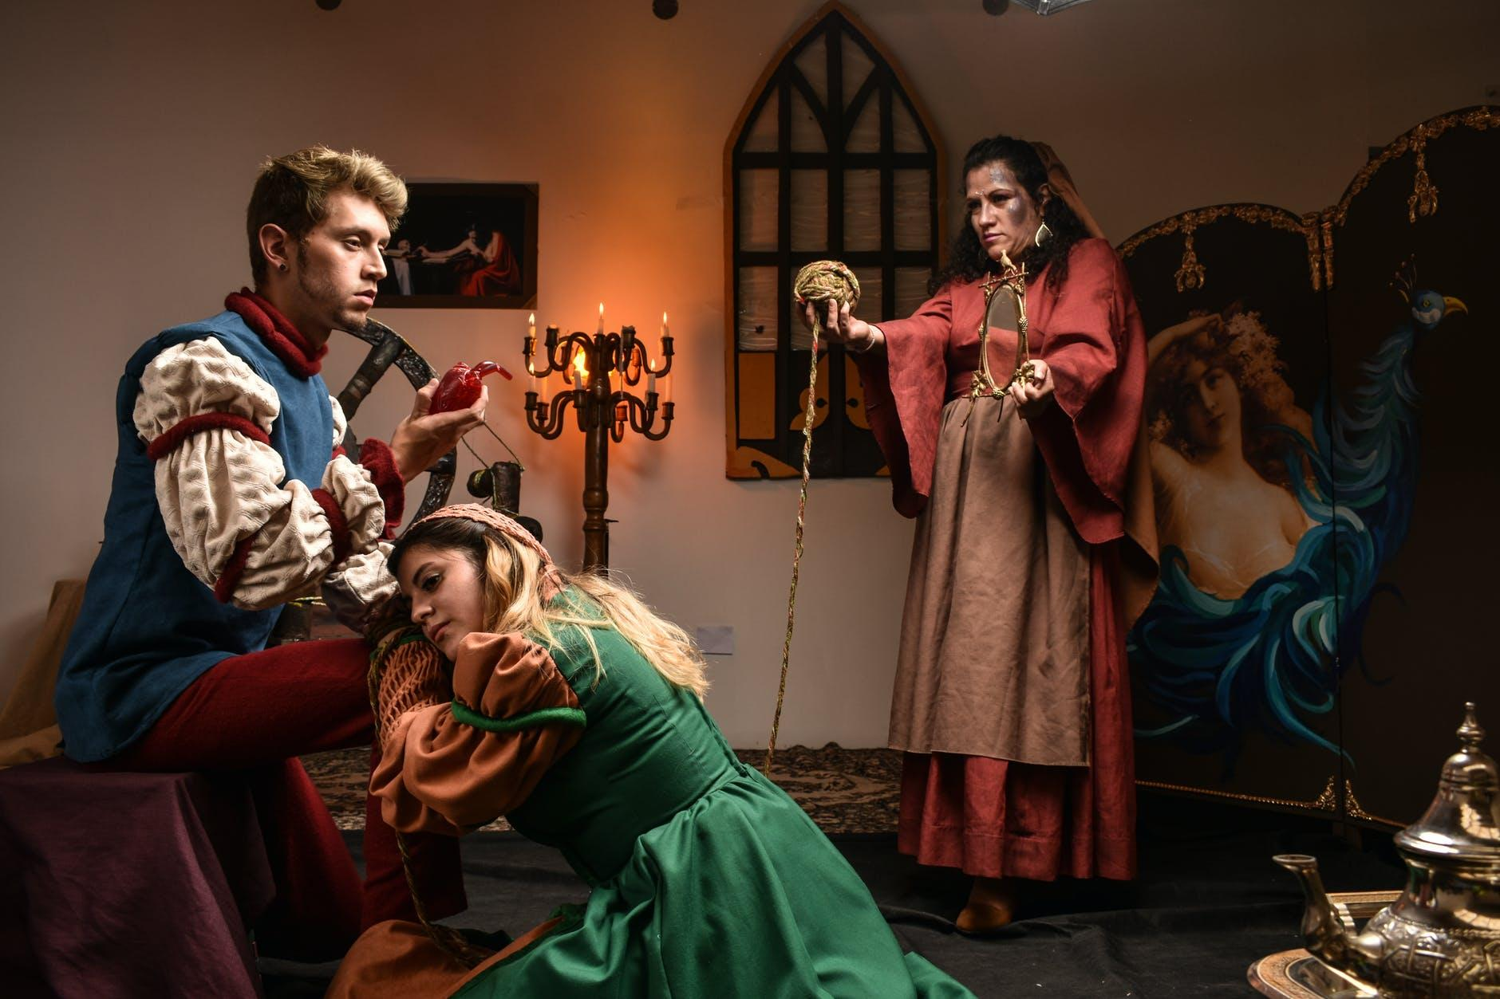
PERFORMANCE
We are going to cover a few tips in this section as a primer to Virtual Performances.
Notes:
Please understand that the tips that we are going to be talking about and being presented do not fully represent and cover all techniques, but it will sure help you get started and give you things to think about.

Slide 4
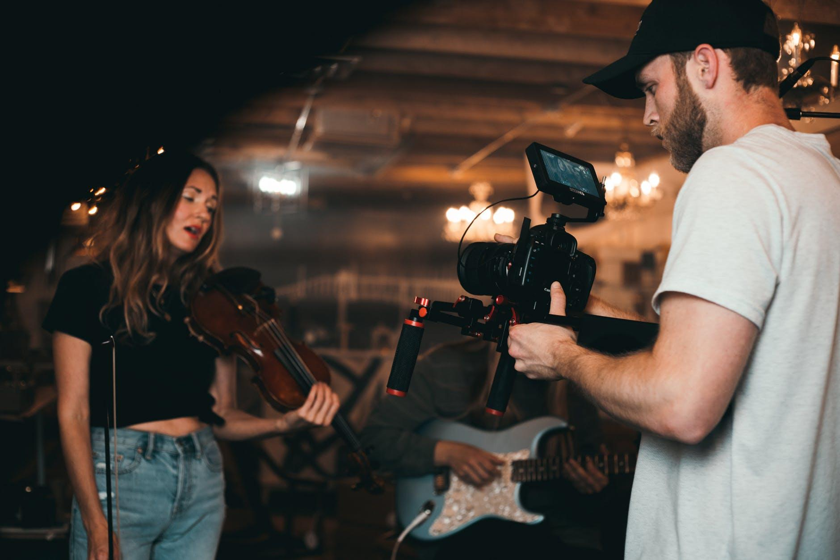
Topics Covered
consider researching how to use simple light set ups to fully light the face and for special effects
use digital backgrounds and the green screen feature to create illusion of virtual actors being in the same space
experiment with props to create the illusion of shared space
learn to use broadcast or switching software to create special effects

Slide 5
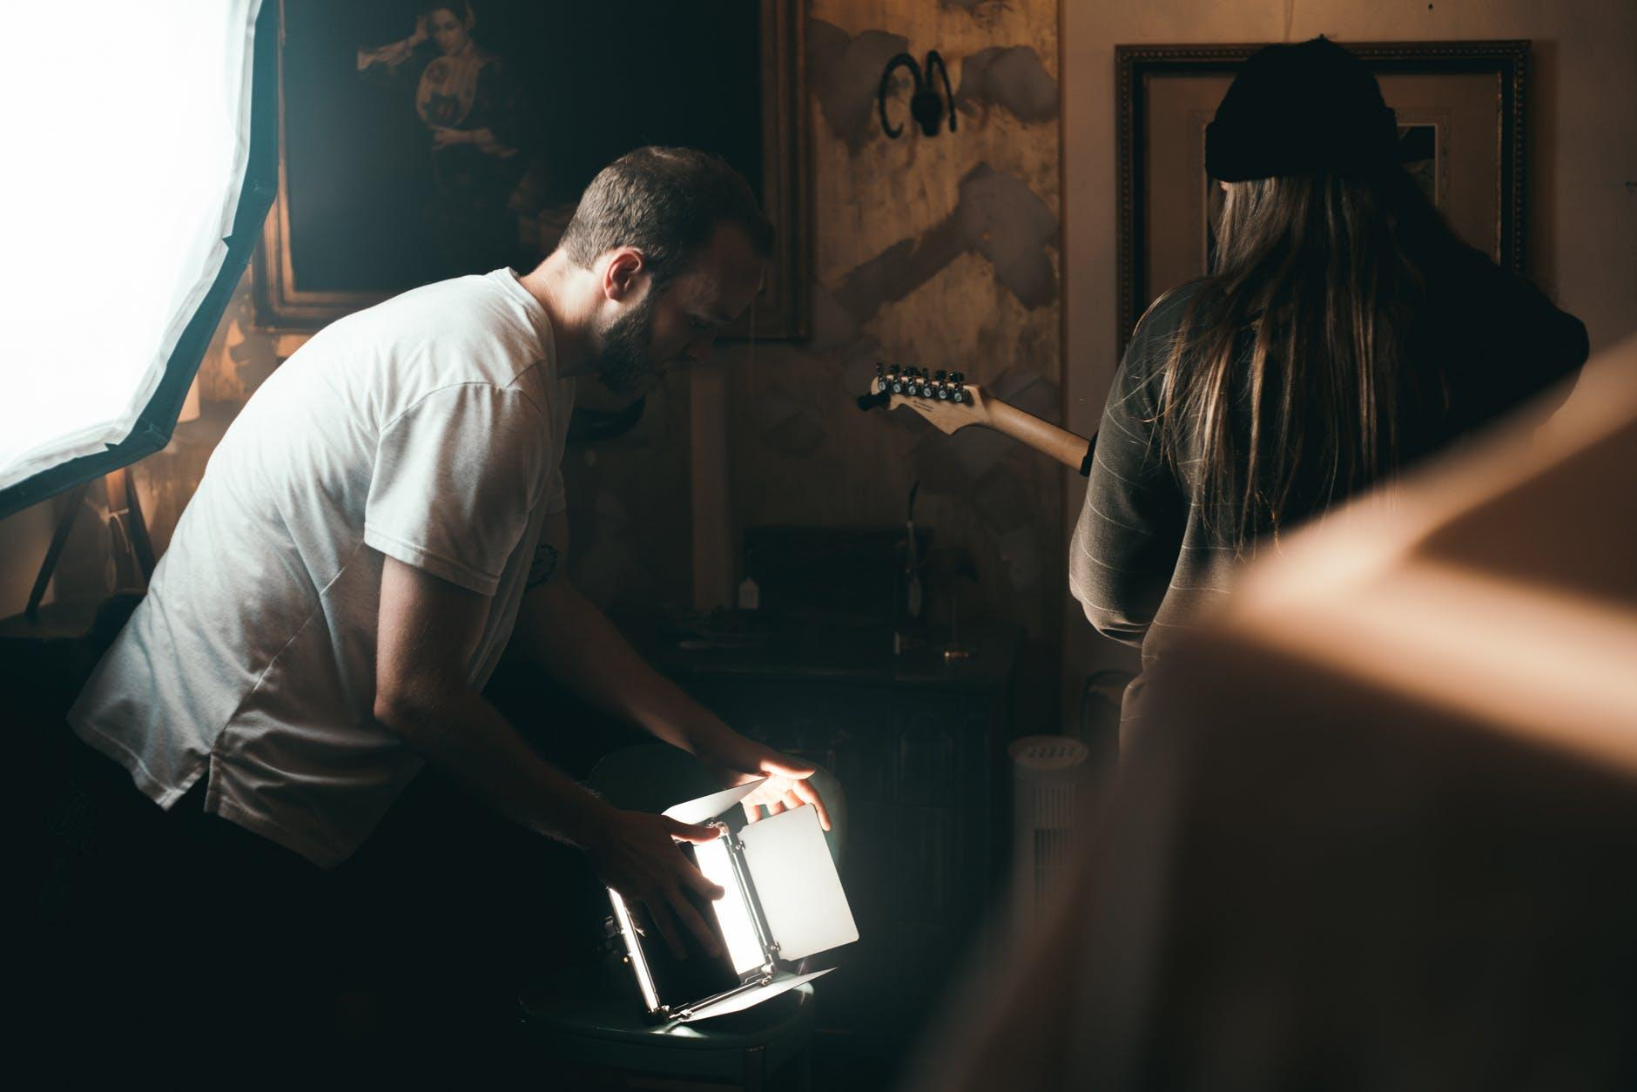
Research Light Setups
Make sure to fully light the face and light for special effects.

Slide 6
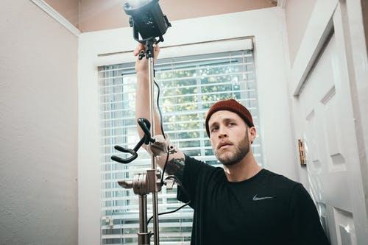
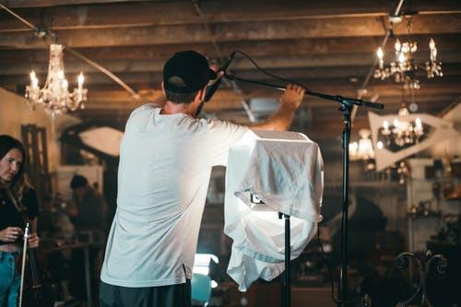
Research Light Setups
Create the perfect lighting situation for your performers.
Remember though; soften and diffuse as much as possible for the camera.
If the light is too harsh-your image is going to bleed on camera and in your files. Your character(s) will be washed out and you will not be able to see them.

Slide 7
Research Light Setups
Sometimes it is better to have natural diffused light from a window.
If using a lamp, point or focus the light on a ceiling or wall and bounce it.
If you are shooting outside; consider filming in the early morning hours or evening hours because of the harsh light from the sun midday to late afternoon.

Slide 8
Use Digital Backgrounds
Utilize a green screen to create the illusion of virtual actors being in the same place.

Slide 9
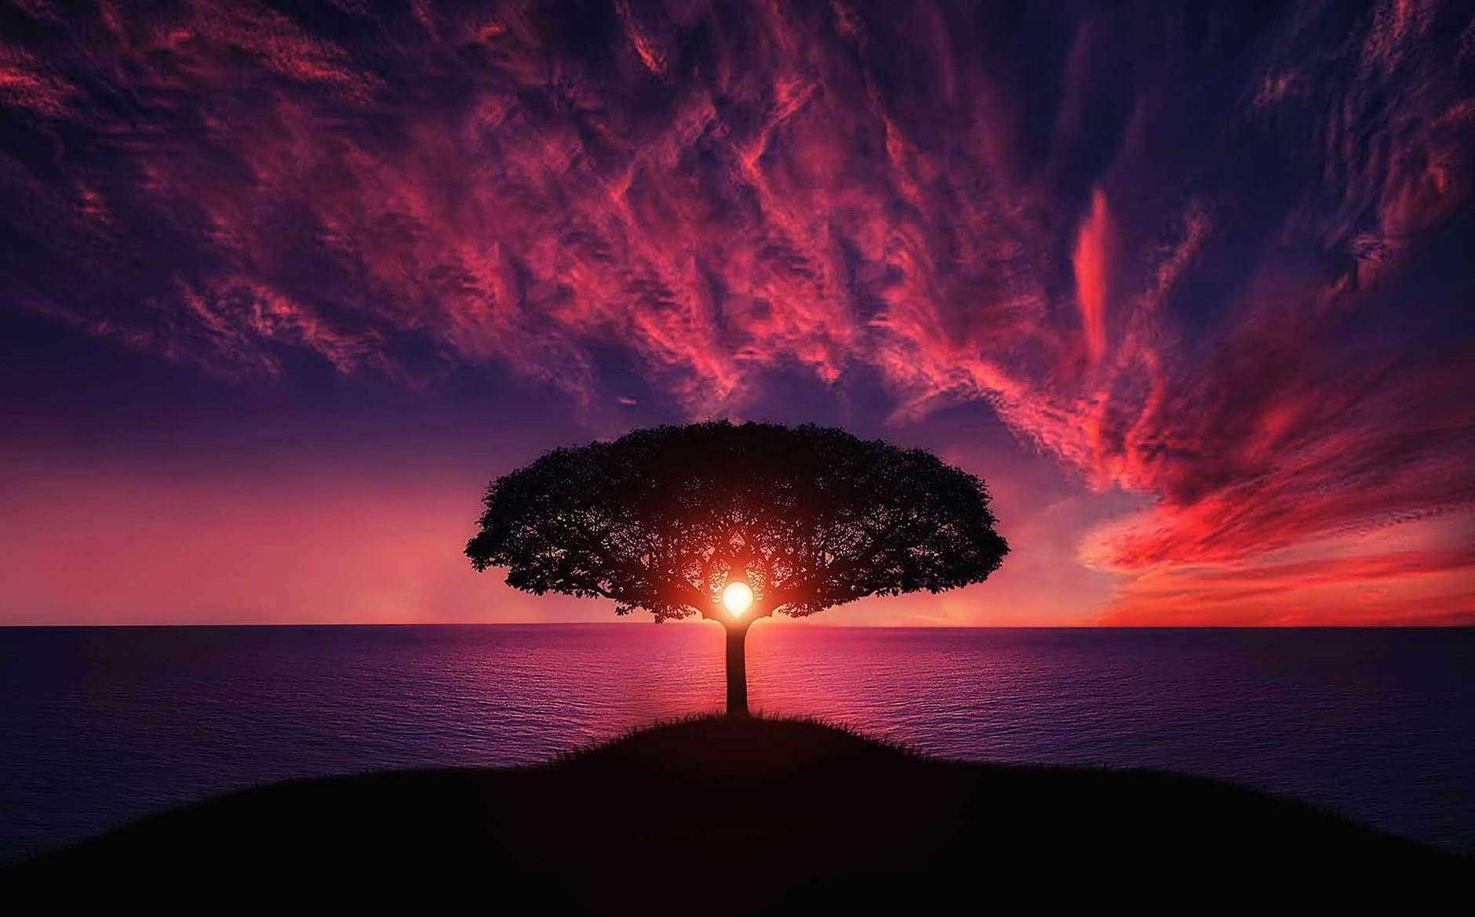
Use Digital Backgrounds
Choosing a background for your performance should be a shared decision by the director and scenic designer.
It needs to be the right image, video, or setting for the scene.
You can search for free static backgrounds online or create your own from photographs you’ve taken or renderings from your production team.

Slide 10
Use Digital Backgrounds
If you’re shooting outside, you should consider if you background is in focus or out.
Also when shooting outside, consider also if your background is moving or stationary.
Make sure that any background, whether moving or static that you are using is royalty free.

Slide 11
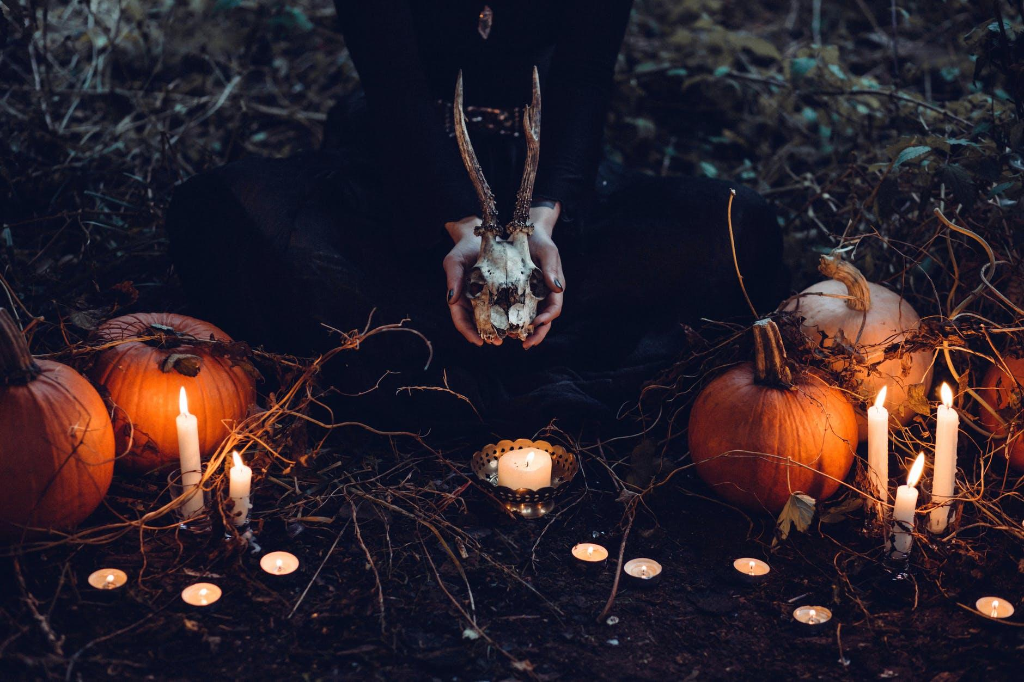
Experiment with Props
Utilize props to create the illusion of virtual actors being in the same place.

Slide 12
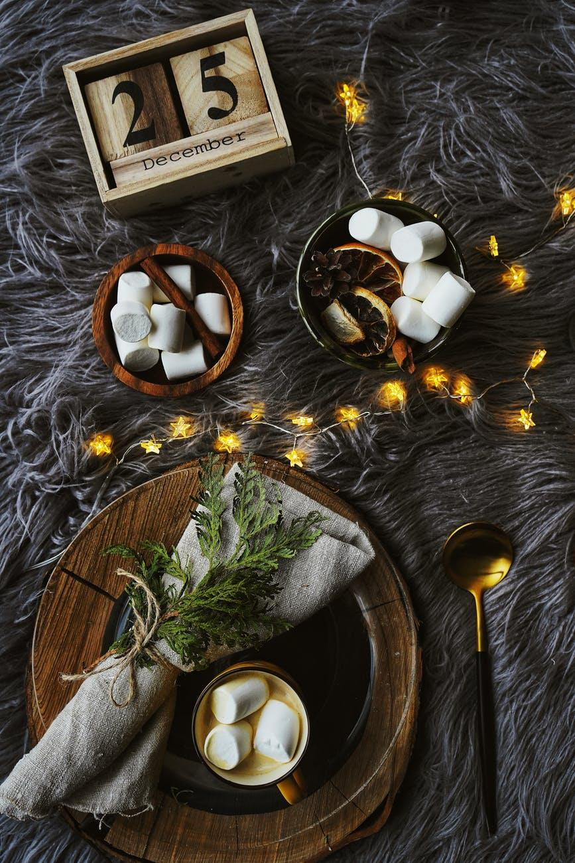
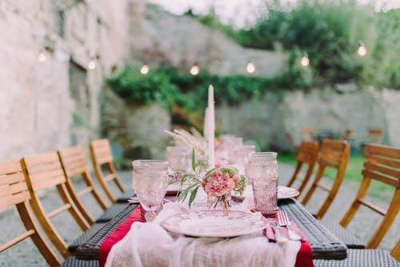
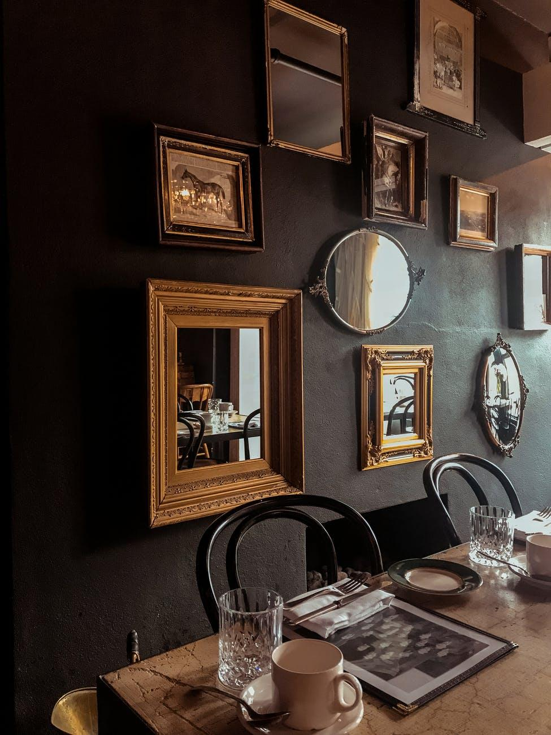
Experiment with Props
Props can give the illusion of a shared space and help out your process and the story for the audience.
A shared prop can be handed off to each other to give the idea that both actors are in the same space.
Make sure the prop though doesn’t distract from the storytelling and doesn’t upstage the actor(s) or action.

Slide 13
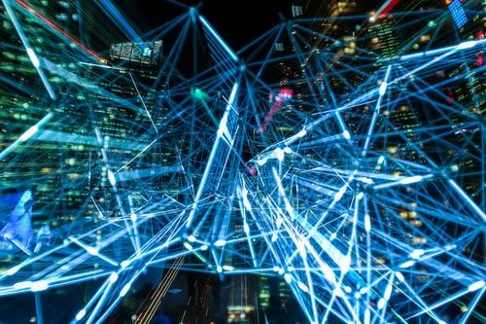
Learn to use Broadcast or Switching Software
These tools can help create special effects, control virtual scenes, and improve performance quality.

Slide 14
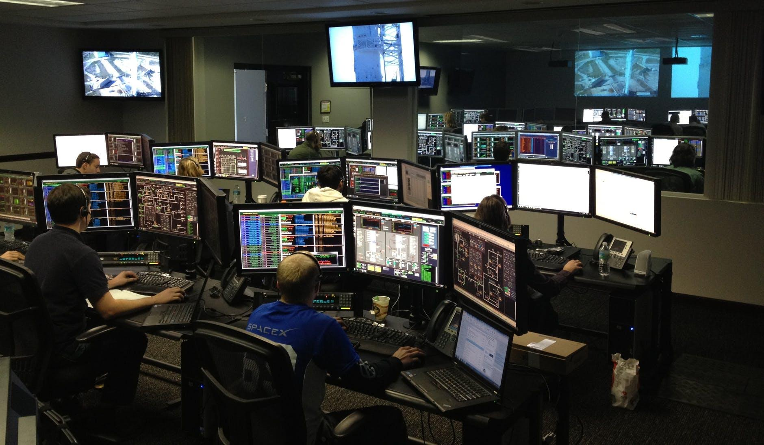
Learn to use Broadcast or Switching Software
There’s some questions that you need to answer before you know exactly what you’re going to need in terms of software.
Is your performance live?
Are there multiple cameras that you’re calling and switching as a live feed?
Are you presenting the show as a live stream?

Slide 15
Learn to use Broadcast or Switching Software
Is all of your content recorded and going to be edited later on?
How do you want to edit your content?
How do you want your content viewed?
The answers that come from all of these questions will tell you what type of software you might need for your exact setup.

Slide 16
Resources - Links
Light Setups
Digital Backgrounds
DIY Lighting for Zoom Meetings;
https://youtu.be/OWgmw_pFMrI
The Easy Way to Light People with Glasses to Avoid Glare;
https://youtu.be/bMj1g9yFuBg
DIY Yourself Video Backgrounds;
https://youtu.be/jlaftGXm8o8
Virtual backgrounds; https://manycam.com/blog/replace-background-on-video-conference-calls/
Background in iMovie;
https://youtu.be/7YvOIVsSFQI
Zoom virtual backgrounds; https://support.zoom.us/hc/en-us/articles/210707503-Virtual-Background

Slide 17
Resources - Links
Digital Backgrounds
Props
Green screen poster board;
https://youtu.be/4wySe_NqfEU
Green screen sheet;
https://youtu.be/Bf8X2k8Y6so
Green screen fabric;
https://youtu.be/leDgPsvOOh8
Teleprompter;
https://youtu.be/f62KR51VE6c
Makeup brush handoff;
https://youtu.be/Zzgz3nD-9rc
Example of connecting the characters;
https://deadline.com/2020/04/stuntman-quarantine-video-cucchallenge-1202915362/

Slide 18
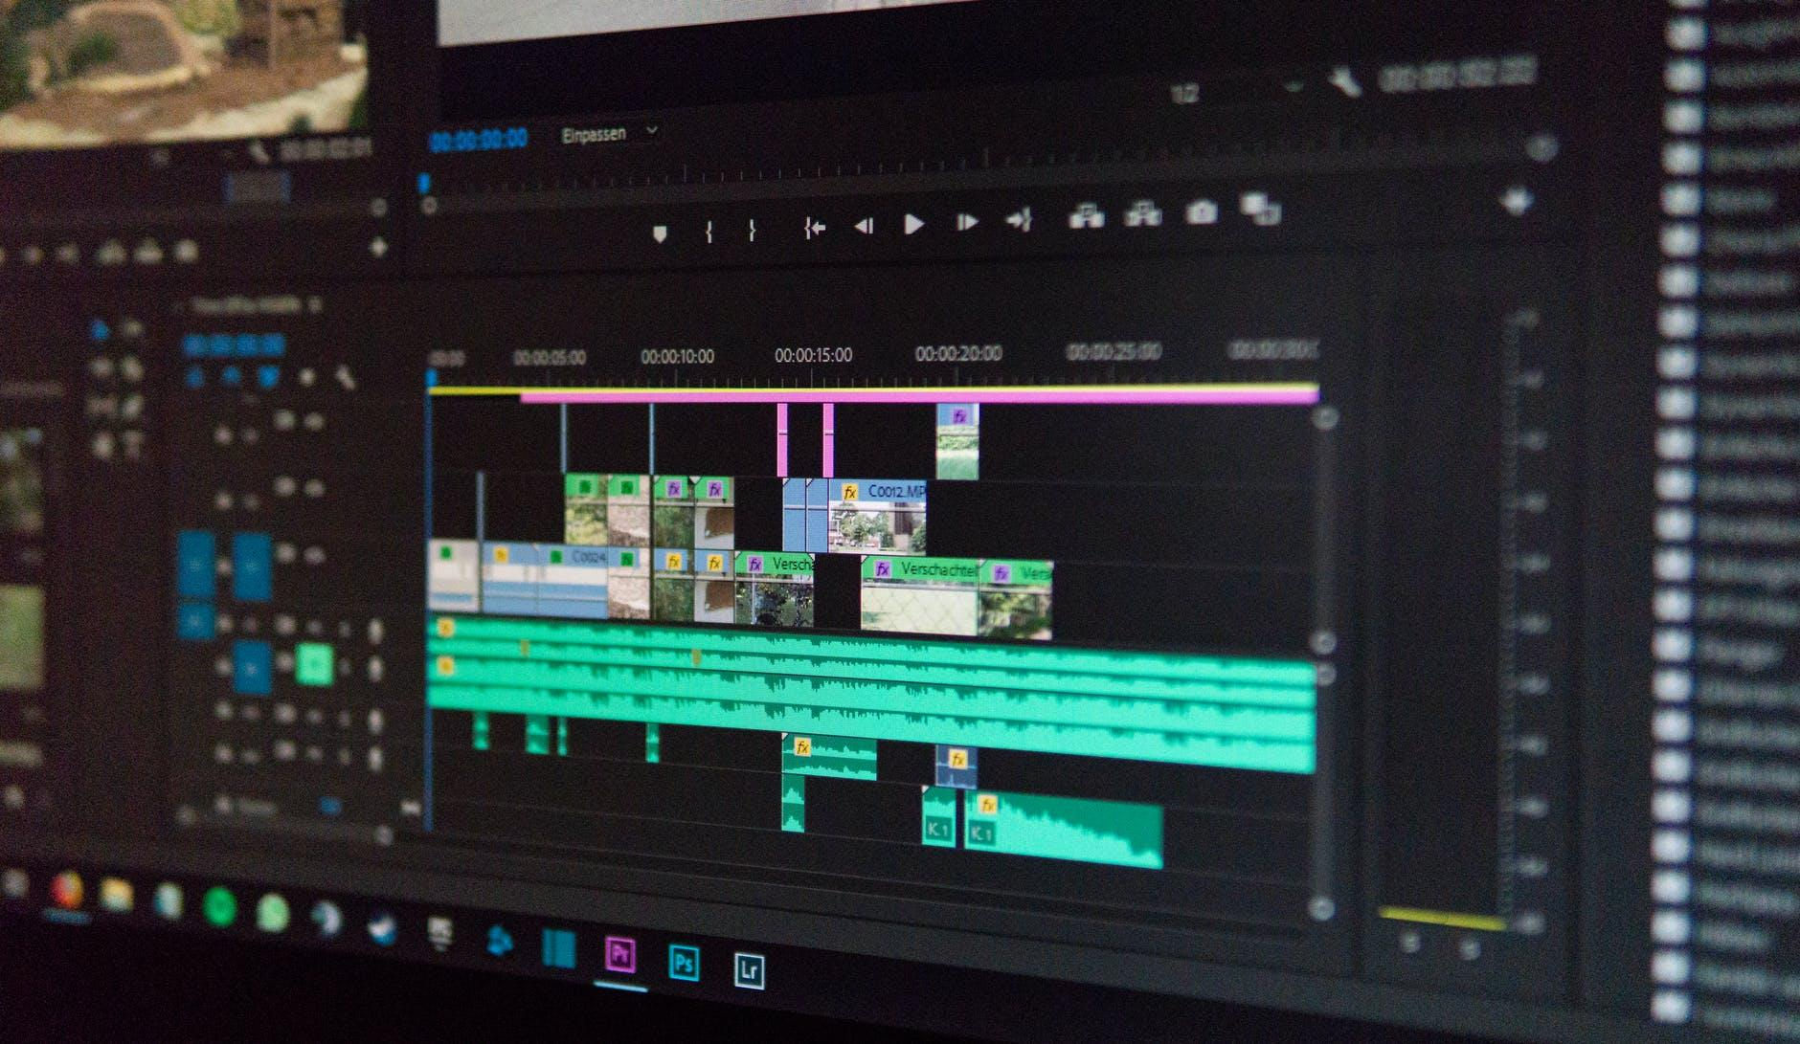
Resources - Links
Software
Live video switching;
https://streamyard.com/
Open broadcaster software;
https://obsproject.com/

